Slide 1

FAKE NEWS DETECTION USING AI
Github Link: https://github.com/pranjalg13/fake-news-detection
TEAM MEMBERS:
Pranjal Goyal (18BCP082)
Priyank Shah (18BCP086)
Priya Patel (18BCP085)
Priyanka Yadav (18BCP087)
Pratvi Shah (18BCP083)

Slide 2
INTRODUCTION TO THE PROBLEM STATEMENT
Fake news is fake or misleading information presented as news or say Fake News may be a spread of disinformation and hoaxes through any news platform. It often has the aim of damaging the reputation of an individual or entity or making money through advertising revenue.
The approaching threat of such widespread misinformation is clear and hence we'll check out ways during which such Fake News are often identified with the assistance of AI. Fake News Detection and analysis is an open challenge in the field of AI!

Slide 3
TYPES OF FAKE NEWS
FAKE NEWS ARTICLE
CLICKBAIT

Slide 4
FAKE NEWS ARTICLE
We are defining “Fake News Article” as those news stories/articles that are false: the story/article itself is fabricated, with no verifiable facts, sources or quotes.
Some fake articles have relatively frequent use of terms seemingly intended to inspire outrage and the present writing skill in such articles is generally considerably lesser than in standard news.

Slide 5
CLICKBAIT
Clickbait is defined as content whose main purpose is to draw attention and encourage visitors to click on a link to a specific website.
Clickbait may be a text or a thumbnail link that's designed to draw in attention and to entice users to follow that link and skim, view, or hear the linked piece of online content, with a defining characteristic of being deceptive, typically sensationalized, or misleading.

Slide 6
DATASET
Here, in our project, we are mainly using 2 datasets each for “Fake News Article” and “Clickbait”. Data is collected by scraping the websites of popular news publishing sources. (Kaggle)
The collected news articles are judged using the score, quality, bias as metrics collected from PolitiFact and Media Charts.

Slide 7
DATASET ATTRIBUTES
The clickbait dataset contains, only two attributes:
Tagline: The main heading of the content
ClickBait: (0 or 1) weather the given news in clickbaited or not.
The Fake news articles contains 6 attributes, the main attributes are:
Title: Title of the article.
Text: Content of the news article
Label: Indicates news article is fake or not

Slide 8
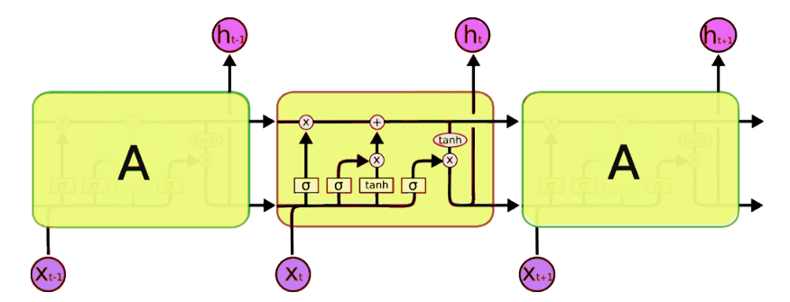
Models
LSTM: Fake-News
LSTM is a variant of Recurrent Neural Network (RNN) which has a memory cell. It performs better than vanilla RNN on long sequential data. LSTM was designed to overcome the vanishing gradient problem in RNN.
All recurrent neural networks have the form of a chain of repeating modules of neural network.
LSTM cells are composed of several gates like input, output and forget gates to preserve memory to a certain extent. At each timestep, LSTM cell can choose to read, write or reset the cell by using an explicit gating mechanism.
We’ve trained our simple LSTM model on a fake news dataset and got an accuracy of 92.7%.
\

Slide 9
Models
Multinomial Naive Bayes: Clickbait-models
Naïve Bayes, which is computationally very efficient and easy to implement, is a learning algorithm frequently used in text classification problems. Two event models are commonly used: 1.Multivariate Bernoulli Event Model 2.Multivariate Event Model.
The Multivariate Event model is referred to as Multinomial Naive Bayes. Naive Bayes is based on Bayes’ theorem, where the adjective Naïve says that features in the dataset are mutually independent.Being relatively robust, easy to implement, fast, and accurate, it is used in many different fields.
Multinomial Naïve Bayes consider a feature vector where a given term represents the number of times it appears or very often i.e. frequency.
The main advantages are:
-> Low computation cost.
-> It can effectively work with large datasets.
-> For small sample sizes, Naive Bayes can outperform the most powerful alternatives.
\

Slide 10
Models
Logistic Regression:
Logistic regression is a classification algorithm used to predict the probability of a target variable. It is a predictive analysis algorithm and based on the concept of probability.
Logistic Regression uses a more complex cost function as compared to linear regression, this cost function can be defined as the ‘Sigmoid function’.
The sigmoid function maps any real value into another value between 0 and 1. In ML, sigmoid function is used to map predictions to probabilities.The hypothesis of logistic regression tends it to limit the cost function between 0 and 1.
Hypothesis representation of Logistic Regression :
hΘ(x) = 1/(1 + e^-(β₀ + β₁X).
\

Slide 11
Models
Random Forest:
Random forest is a supervised learning algorithm.Random forest can be used for both classification and regression problems, which form the majority of current machine learning systems.
Random forests (RF) are basically a bag containing n Decision Trees (DT) having a different set of hyper-parameters and trained on different subsets of data.
Instead of relying on one decision tree, random forest builds multiple decision trees and merges them together to get a more accurate and stable prediction.
The detailed Working of Random Forest can be described as below:
--> First, select random samples from a given dataset.
--> Then this algorithm will construct a decision tree for every sample. Then it will get the prediction result from every decision tree.
--> In the next step, voting will be performed for every predicted result.
--> At last, select the most voted prediction result as the final prediction result.
The greater number of trees in the forest leads to higher accuracy and prevents the problem of overfitting.
\

Slide 12
Models
Passive Aggressive:
Passive-Aggressive Algorithms are generally used for large-scale learning. It's one among the few 'online-learning algorithms'. It works by responding as passive for proper classifications and responding as aggressive for any miscalculation.
Passive-Aggressive Algorithms are somewhat almost like a Perceptron model, within the sense that they are doing not require a learning rate. However, they are doing include a regularization parameter.
Passive Aggressive Classifier is where you'll train a system incrementally by feeding it instances sequentially, individually, or in small groups called mini-batches and thus, it ​is best for systems that receive data during a continuous stream.
Passive-Aggressive Algorithms are called so because:-
--> Passive: If the prediction is correct, keep the model and don't make any changes. i.e., the data within the example isn't enough to cause any changes within the model.
--> Aggressive: If the prediction is wrong/incorrect, make changes to the model. i.e., some change to the model may correct it.
\

Slide 13
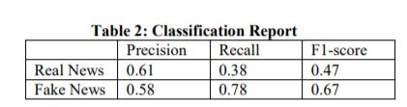
Literature Survey
Fake News:
1) Kumar, A., Singh, S., & Kaur, G. (2019). Fake News Detection of Indian and United States Election Data using Machine Learning Algorithm. International Journal of Innovative Technology and Exploring Engineering (IJITEE), 8(11), 1559-1563.
The results of Linear Regression performed by Training with US dataset. The Precision, Recall, F1-score can be seen which gave the accuracy score of 59 % according to the IJITEE.
The dataset used by IJITEE , the first data has been collected from kaggle repository which focuses on US-based presidential election.. In this research include (6335 X 3), which means 6335 rows and three columns.
The classification report is as follows:

Slide 14
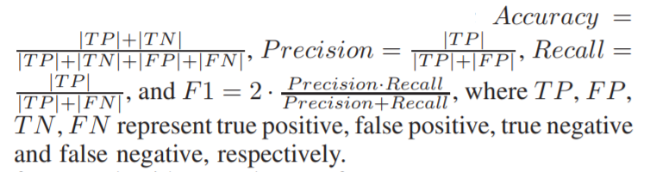
Literature Survey
Fake News:
2) Shu, K., Wang, S., & Liu, H. (2017). Exploiting Tri-Relationship for Fake News Detection. arXiv preprint arXiv:1712.07709.
This paper explored the correlations of publisher bias, news stance, and relevant user engagements simultaneously, and propose a Tri-Relationship Fake News detection framework (TriFN).
To evaluate the performance of fake news detection algorithms, we use the following metrics, which are commonly used to evaluate classifiers in related areas.
TriFN achieves average relative improvement of 9.23%, 8.48% on BuzzFeed and 6.94%, 8.24% on PolitiFact, comparing with LIWC+Castillo in terms of Accuracy and F1 score.

Slide 15
Literature Survey
ClickBait:
1) Potthast, M., Köpsel, S., Stein, B., & Hagen, M. (2016). Clickbait Detection. Advances in Information Retrieval, 810–817. doi:10.1007/978-3-319-30671-1_72
Potthast at el. split their own sample Twitter corpus into datasets for training and testing at a 2:1 training-test ratio.
Their clickbait detection model is based on 215 features, and those features are divided into three categories pertaining to (1) the teaser message, (2) the linked web page, and (3) meta information.
They apply and compare the three well-known learning algorithms logistic regression, naive Bayes, and random forest using default parameters.
After comparison, they developed a clickbait model based on 215 features that enables a random forest classifier to achieve 0.76 precision and 0.76 recall.

Slide 16
Literature Survey
ClickBait:
2) Zuhroh, N. A., Rakhmawati, N. A.(2019). Clickbait detection: A literature review of the methods used. Scientific Journal of Information System Technology, 6(1), 1-10. DOI:10.26594/register.v6i1.1561
There is a need for a literature review to determine various previous methods and approaches. Therefore, this literature review 1) provides a summary of the earlier methods used, and 2) analyzes several methods and previous research.
The researcher identified several detection steps from the literature. These include (1) Collection of clickbait and non-clickbait news articles from several social media and sites, with labeling initially carried out manually by several volunteers. (2) Data preprocessing in the form of cleaning. (3) Analysis of feature selection. (4) Its classification, which explains the techniques used in clickbait detection.
The 21 literature studies showed that clickbait is detected using a machine learning classification algorithm with deep learning and neural network approaches. Therefore, machine learning-based research often uses the Random Forest algorithm, while deep and neural network makes use of CNN, BiLSTM, BiGRU, and Multilayer Perceptron.

Slide 17
Proposed Methodology
Fake News Detection:
LSTM(Long short-term memory): It is a type of recurrent neural network capable of learning order dependence in sequence prediction problems.
For the corpus part the input text was cleaned and pre-processed and then it was converted to one hot encoding and after that we applied padding sequences so that inputs that have the same shape and size.
The train-test split was 70:30.
Clickbait Detection :
Firstly cleaning and pre-processing of the dataset was done by removing stop words,punctuation marks and null rows.
Multinomial NB, Logistic Regression, Random Forest and Passive Aggressive models were used with TF-IDF Vectorizer and the best performing model, Multinomial NB was used for the website.
The train-test split was 80:20.

Slide 18
Results
The LSTM model used for prediction of Fake news have an accuracy of 92.7%.
Multinomial NB model with TF IDF Vectorizer used for prediction of Clickbait has an accuracy of 96.7%. Other models (with TF IDF) were with accuracy:
Model | Accuracy
Multinomial NB model | 96.7%
Logistic Regression model | 94.9%
Random Forest model | 92.1%
Passive Aggressive model | 96.1%

Slide 19

Website Implementation
HomePage:

Slide 20
FUTURE SCOPE
Here, in our project, we are mainly focusing on the type “Fake News Article” but in near future if there is a need to expand this project then we can work on types of fake news like “Political Fake News.” Since Dataset of Indian Political Fake News is not available currently.
The model can be further optimized by using Bi-directional LSTM model for the Fake News Detection.
Also, further this project can be extended by using the datasets of fake news from WhatsApp or twitter or other sources. This would a sort of Plugin we can install in whatsapp and other social media platforms.

Slide 21
References:
Fake News DataSet:
(https://www.kaggle.com/c/fake-news/data?select=train.csv)
ClickBait Dataset:
(https://www.kaggle.com/amananandrai/clickbait-dataset)
Research Paper:
Fake News :
https://www.ijitee.org/wp-content/uploads/papers/v8i11/K18290981119.pdf
https://link.springer.com/chapter/10.1007%2F978-981-15-8354-4_26
https://cutt.ly/Fbdhm1J
Clickbait:
https://link.springer.com/chapter/10.1007/978-3-319-30671-1_72
https://cutt.ly/2bdhA9p

Slide 22
Thank You!
https://docs.google.com/presentation/d/1Dg91dsjLGi5x-FYmf-SwO9Q49WNAHhOOb3Ddf3jBHsI/edit?usp=sharing

